Slide 1
College Scorecard
November 2, 2019
Team Scorecard

Slide 2
Overview
Making college decisions involves many variables
One important variable is the monetary return after graduation
This has the potential to determine university choice

Slide 3
Dataset
College Scorecard from the Department of Education
Follows students post graduation for each school and tracks a number of data points

Slide 4
Dataset- Data Points
School the students attended
Demographics
Admission rate
School types
Mean and median earnings after graduation(6,8, & 10 years)

Slide 5
Questions
What type of institution has the highest earning potential?
What schools provide the highest earnings after graduation?
What are some of the factors that influence your earnings post graduation?
Are the schools with the highest monetary return concentrated in one area of the United States?

Slide 6
Analysis
Institution type
Admission rate
Earnings after graduation
Influencing factors on earnings after graduation
Concentration of top earning potential college locations

Slide 7
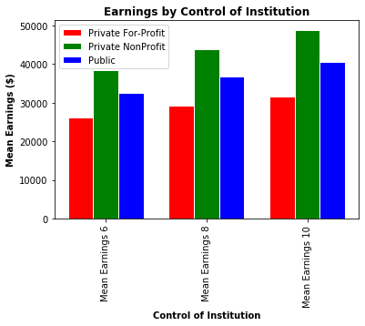
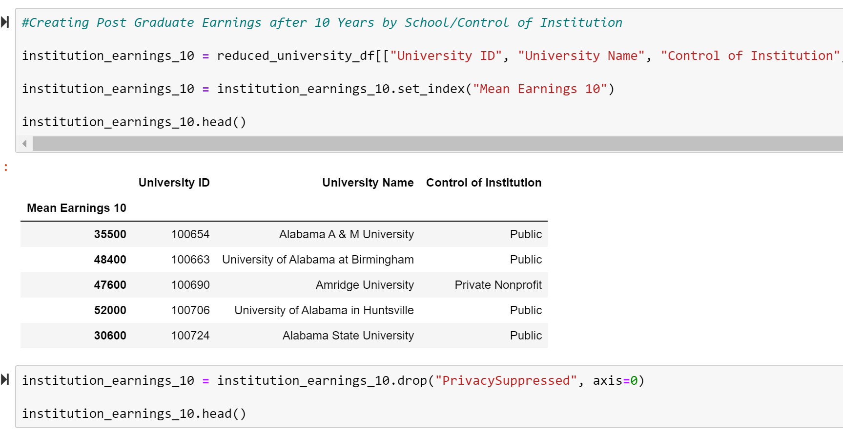
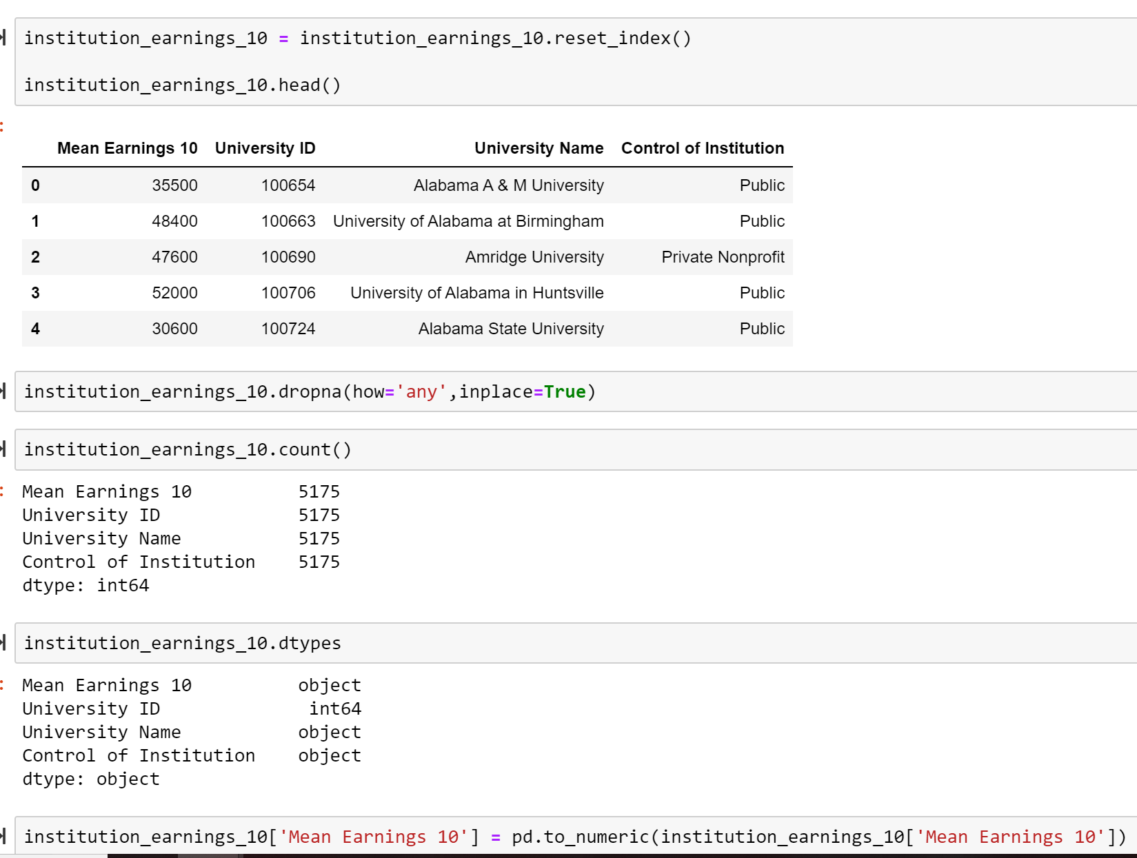
Earnings by Control of Institution

Slide 8
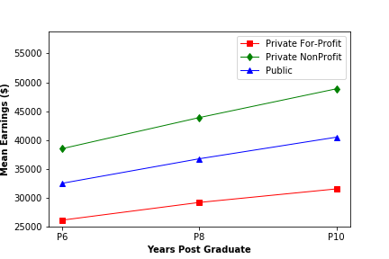
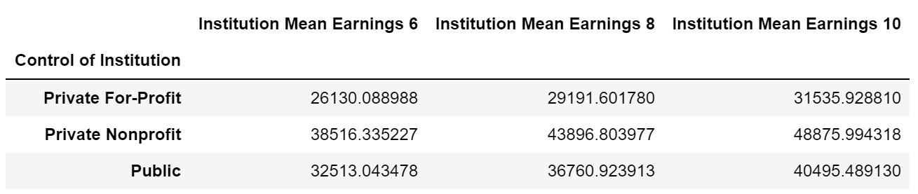
Means Earnings Trend by Years Post Graduation (years 6 to 10)
Notes:
Looking over time Private NonProfit earns 10K more than

Slide 9
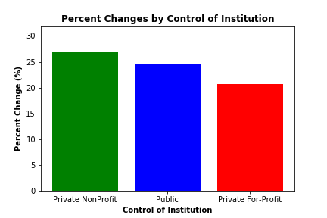
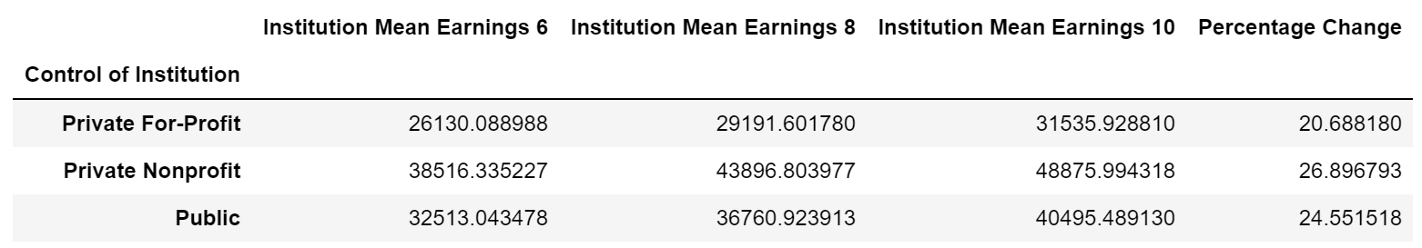
Earnings Percent Change(4 year change from years 6 to 10 Post Graduation)

Slide 10
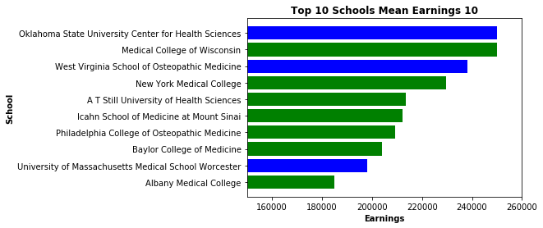
Top 10 Schools by Mean Earnings After 10 Years

Slide 11
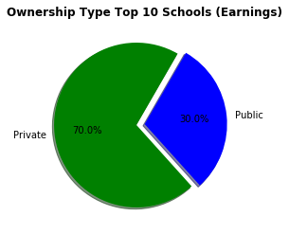
Top 10 Schools by Ownership Type

Slide 12
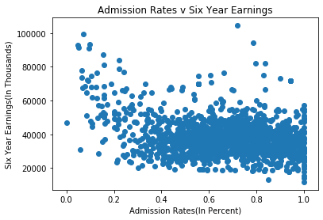
Admission Rates vs. Six Year Earnings

Slide 13
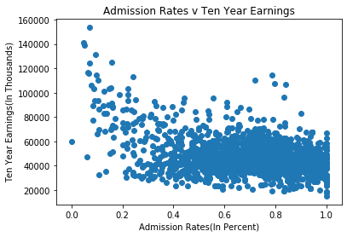
Admission Rates vs. Ten Year Earnings

Slide 14
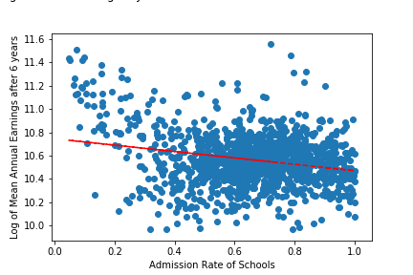
Log of Mean Annual Earnings After Six Years vs Admission Rate

Slide 15
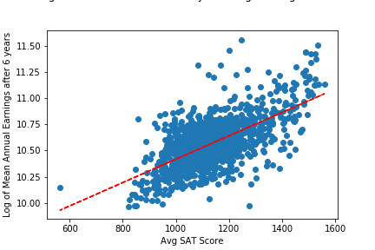
Log of Mean Annual Earnings after 6 Years vs. Average SAT Score

Slide 16
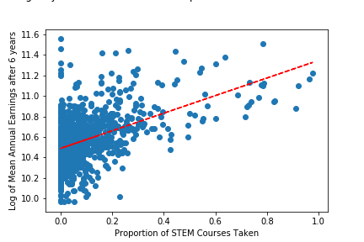
Log of Mean Earnings After 6 years vs. Proportion of STEM courses taken

Slide 17
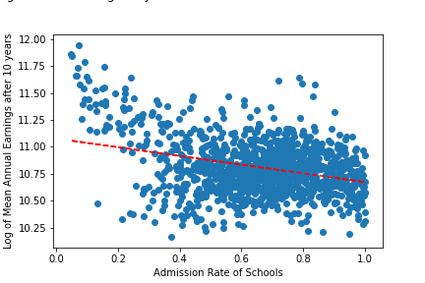
Log of Mean Annual Earnings After Ten Years vs Admission Rate

Slide 18
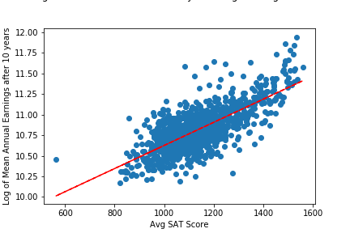
Log of Mean Annual Earnings after 10 Years vs. Avg SAT Score

Slide 19
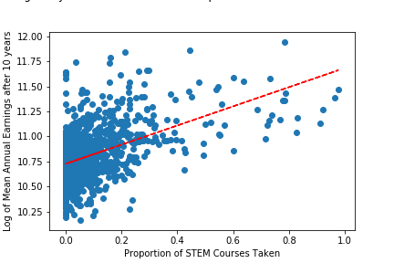
Log of Mean Annual Earnings After 10 Years vs. Proportion of STEM Courses Taken

Slide 20
Regression Output
Model: | OLS | Adj. R-squared: | 0.589
Dependent Variable: | Mean 10yr Earnings Post Graduation | AIC: | 26886.0233
Date: | 2019-10-31 19:22 | BIC: | 26916.9134
No. Observations: | 1272 | Log-Likelihood: | -13437.
Df Model: | 5 | F-statistic: | 365.6
Df Residuals: | 1266 | Prob (F-statistic): | 1.16e-242
R-squared: | 0.591 | Scale: | 8.8122e+07

Slide 21
Regression Output
 | Coef. | Std.Err. | t | P>|t| | [0.025 | 0.975]
const | -18980.7781 | 3373.1107 | -5.6271 | 0.0000 | -25598.2802 | -12363.2761
Region | -646.2174 | 137.0806 | -4.7141 | 0.0000 | -915.1475 | -377.2873
Institution Ownership Type | 1928.5687 | 563.2144 | 3.4242 | 0.0006 | 823.6324 | 3033.5051
Admission Rate | -7334.5821 | 1474.7342 | -4.9735 | 0.0000 | -10227.7740 | -4441.3901
Avg SAT Score | 63.6216 | 2.4489 | 25.9798 | 0.0000 | 58.8173 | 68.4260
STEM Degree Total | 30461.2141 | 2379.6730 | 12.8006 | 0.0000 | 25792.6774 | 35129.7508

Slide 22
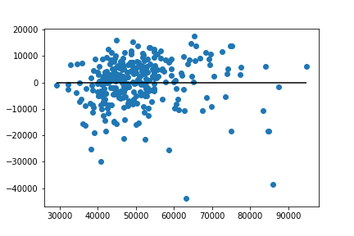
Regression Output

Slide 23
Degrees with the Highest Potential Earnings After 6 and 10 years
Chart showing the respective STEM degrees and their mean earnings after 6 and 10 years respectively

Slide 24
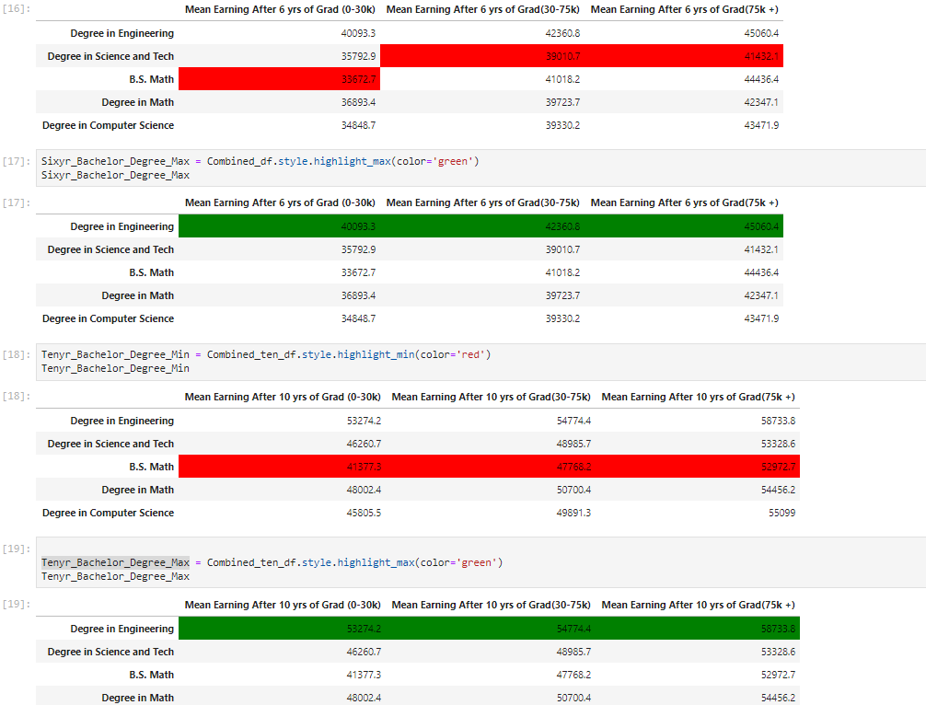

Slide 25
Geographical Visualizations
Heat map of Top 50 universities with highest earnings 10 years after graduation
Bar graph of top 10 states with highest earnings 10 years after graduation
Map plot of top 10 states with highest earnings 10 years after graduation

Slide 26
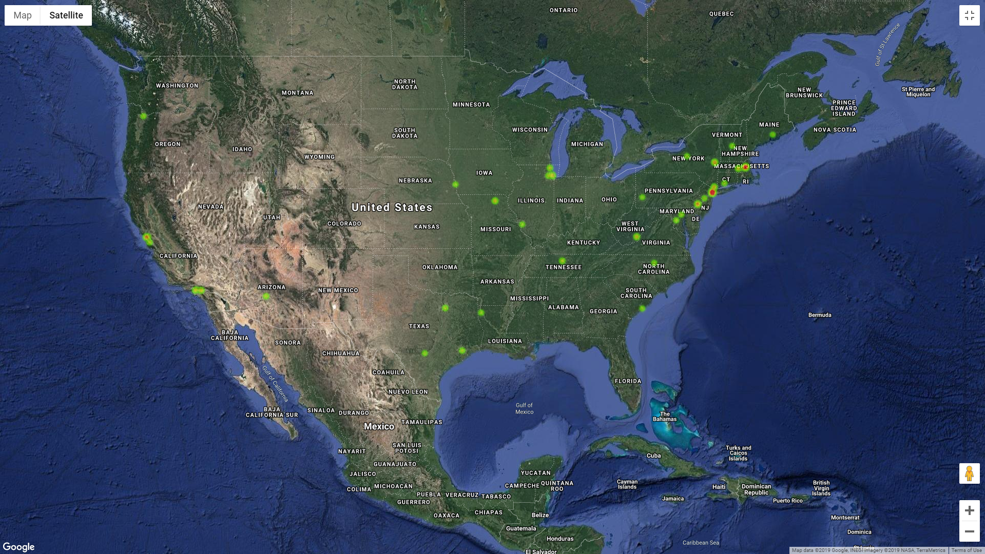

Slide 27
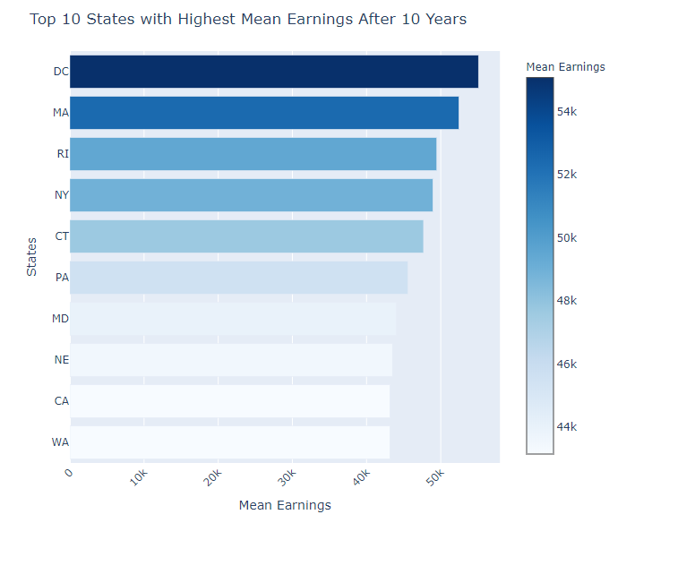

Slide 28
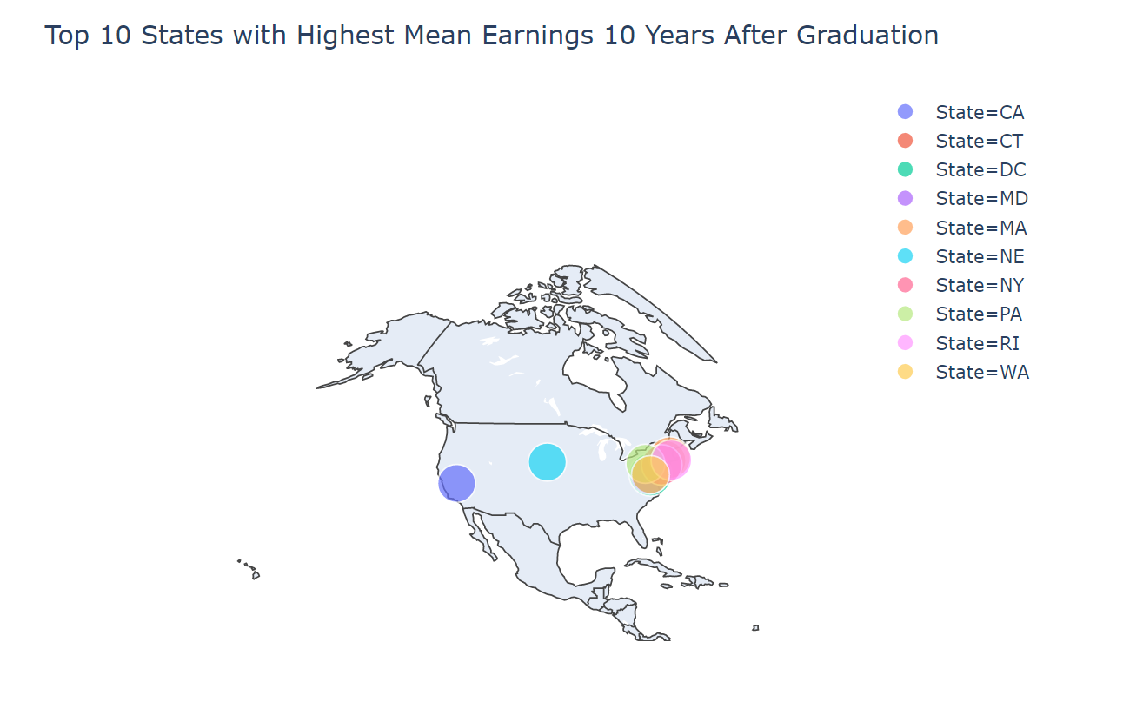

Slide 29
Concluding Remarks
Making college decisions vis-a-vis earnings is a complex process
While some factors influence choice, as more data becomes available, predictive models will get more accurate
Based on the regression, region, admission rate, institution type, SAT score, and % of STEM courses explain a 0.6% variation in salary after 6 to 10 years

